Slide 1
The 2023 Financial Crisis
Understanding What is Happening

Slide 2
18 U.S. Code §241 - Conspiracy Against Rights
If two or more persons conspire to injure, oppress, threaten, or intimidate any person in any State, Territory, Commonwealth, Possession, or District in the free exercise or enjoyment of any right or privilege secured to him by the Constitution or laws of the United States, or because of his having so exercised the same; or
If two or more persons go in disguise on the highway, or on the premises of another, with intent to prevent or hinder his free exercise or enjoyment of any right or privilege so secured—
They shall be fined under this title or imprisoned not more than ten years, or both; and if death results from the acts committed in violation of this section or if such acts include kidnapping or an attempt to kidnap, aggravated sexual abuse or an attempt to commit aggravated sexual abuse, or an attempt to kill, they shall be fined under this title or imprisoned for any term of years or for life, or both, or may be sentenced to death.
(June 25, 1948, Ch. 645, 62 Stat. 696; Pub. L. 90–284, title I, § 103(a), Apr. 11, 1968, 82 Stat. 75; Pub. L. 100–690, title VII, § 7018(a), (b)(1), Nov. 18, 1988, 102 Stat. 4396; Pub. L. 103–322, title VI, § 60006(a), title XXXII, §§ 320103(a), 320201(a), title XXXIII, § 330016(1)(L), Sept. 13, 1994, 108 Stat. 1970, 2109, 2113, 2147; Pub. L. 104–294, title VI, §§ 604(b)(14)(A), 607(a), Oct. 11, 1996, 110 Stat. 3507, 3511.)

Slide 3
Fair Use Notice
The images and videos used in this presentation belong to their respective copyright holders.
These images and videos used in this presentation are used for education, criticism, comment, teaching, and research constituting a Fair Use Exemption under §107 of the United States Copyright Act of 1976.
“Fair Use” is defined as a use permitted by copyright statute that might otherwise be considered infringement.

Slide 4
From The floor Of the European Parliament

Slide 5
How Did We Get in This Mess?
As with most things we need to study the history of banking.
Once we study the history of banking, we can understand how things came into being and analyze how each element.
Then, we need to apply the scriptures to each element and use them to both determine the validity and to understand what the result will be.

Slide 6
Scriptures
And the great city was divided into three parts, and the cities of the nations fell: and great Babylon came in remembrance before YHWH, to give unto her the cup of the wine of the fierceness of his wrath. (Revelation 16:19)
Standing afar off for the fear of her torment, saying, Alas, alas, that great city Babylon, that mighty city! for in one hour is thy judgment come. (Revelation 18:10)

Slide 7
Banking in Ancient History
Banking got its start in Early Babylon.
People making trips would store their precious metals in “banks” and receive cuneiform tablets (paper money would come much later) representing their holdings in that bank.
The bank would take a percentage of the stored metal as payment.
Later, these tablets were replaced by coins minted by the banks.

Slide 8
Banking in Ancient History
Seeing it was such a good business, national governments Took Over the Minting of Coins in Israel, Greece, and Persia
Rome also minted it own coins, but as Roman History continued, the value of the metals in the coins decreased.
After Rome fell, in the West, bartering took over in the Dark Ages. Governments did not coin money until the 15th century.

Slide 9
Banking in the Middle Ages
The First Crusade (1096-1099) saw the Knights Templar loot Jerusalem (Solomon’s Treasure) and bring that wealth back to Europe.
This led to the creation of the Banco del Giro in Venice in 1157. It collapsed after the Venetians lost the Byzantine-Venetian War of 1171 and the Doge Vitale II Michael was assassinated.
The Venetians got their revenge with The Fourth Crusade (1202-1204), which saw the Crusaders manipulated into attacking Constantinople to loot its wealth and transfer it initially, to Venice to pay back the “loans” and the rest was repatriated to the German states.
The re-establishment of banks in Venice and Florence would not occur until the early 14th century when several private banks began doing business.

Slide 10
Transfer of Wealth to Europe
The Royal Families of Europe found themselves held hostage to the bankers of Venice and the Pope of Rome.
When a Family wanted to go to war, they had to arrange financing for their upcoming war with the bankers of Venice.
In time, the Venice bankers created branches in Frankfurt, Paris, and London. When politics in southern Europe began to destabilize in the late 18th century, they moved their operations to their branches in Central and Northern Europe. We saw the Rothchild Family take over much of these banking activities.

Slide 11
The Banking Issues in the United States
When the United States was formed, the 13 colonies had their own banks. With the ratification of the Constitution in 1791, banking was centralized in Congress:
To coin Money, regulate the Value thereof, and of foreign Coin, and fix the Standard of Weights and Measures; (Section 8 ¶6)
To provide for the Punishment of counterfeiting the Securities and current Coin of the United States; (Section 8 ¶7)

Slide 12
The Banking Issues in the United States
The United States tried several banking systems in the early part of the 19th century. All of them were failures.
To finance the Civil War, President Lincoln and Congress began issuing paper money. It would soon replace the five-, ten-, and twenty-dollar gold and silver coins.
The Panics of 1896 and 1907 convinced Congress to pass the Federal Reserve Act of 1913.

Slide 13
The “Federal” Reserve
The Federal Reserve consists of 12 Central Banks throughout the country to manage and control monetary flows.
These 12-member central banks are owned by local banks who own stock in them.
Each of these Member banks is managed by a “governor” who is appointed by the President and confirmed by the Senate. These governors and the chairman govern the Federal Reserve.

Slide 14
The Open Market Committee
The FMOC meets eight times a year to direct all “open market operations” of the Federal Reserve. They set the interest rates.
The Federal Open Market Committee (FOMC) was formed in 1933 to:
Promote Effectively the Goals of Maximum Employment
Stabilize Prices
Moderate Interest Rates

Slide 15
Interest Rate Analysis
The Federal Reserve Open Market Committee uses interest rates to manage the national economy.
When the economy is doing well, interest rates are raised to control monetary inflation.
When the economy is in recession, interest rates are lowered to stimulate the national economy.
*Federal Reserve Chairman Paul Volker testifying before Congress in 1981, Courtesy of the New York Times

Slide 16
Interest Rates
Here is a chart outlining the history of interest rates since 1950.

Slide 17
Interest Rates
Here is a chart outlining the history of interest rates since 2018.

Slide 18
Trump Financial Policies
When Donald Trump was elected president, he mandated that interest rates should be raised at slight intervals to control inflation and to reduce financial risks in the marketplace.
A reasonable interest rate discourages risky investments. It also insures that people will get a reasonable return on their savings.
When inflation was deemed to be controlled in 2018, interest rates were lowered.

Slide 19
The 2020 Panic
When it was deemed there was a “Pandemic” in the offing, the Federal Reserve lowered interest rates to zero.
Suddenly, the Venture Capital Companies started investing in business startups that they would not normally consider.
Even Silicon Valley Bank [NASDAQ: SIVB - Trading Halted March 9, 2023] started loaning money to “woke” startups.

Slide 20
The Silicon Valley Bank Debacle
Red Circle Indicates Bank “Run”

Slide 21
Silicon Valley Bank Analysis
During the 2019-2021 Period, the bank received SIX BILLION DOLLARS in new deposits that they needed to invest to offset their “Cost of Capital” requirements.
Remember, all business accounts are paid interest equivalent to the Bank Prime Rate set by the Federal Reserve!
The bank’s management opted to invest in 10-year Treasury Bonds at an interest rate of 1.68%.
Many investment managers would consider this investment sound, were it not for the trend of rising interest rates.

Slide 22
Silicon Valley Bank Analysis
Unfortunately, we have seen that interest rates have risen from the 1-2% they were when they made most of these investments to 4.5% now.
Bank management was not initially concerned because they planned to hold the bonds until they matured in ten years.
However, on their financial statements, due to the “mark to Market” method of accounting (FAS #157), they must show an “unrealized loss” on those treasury bonds and other low interest investments.
One must wonder if the Bank’s management was aware of this accounting rule.
We do know that the Bank did not have a risk manager for several months.
Normally, publicly-traded banks carry insurance to “hedge” against these kinds of risks to their portfolio.

Slide 23
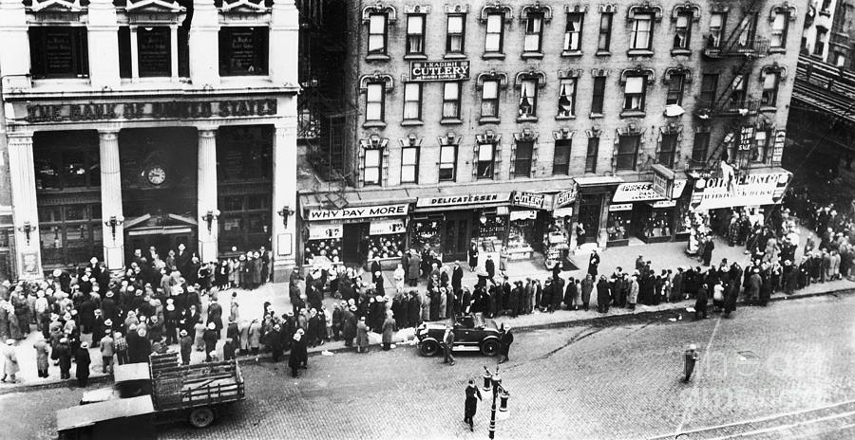
Silicon Valley Bank Analysis
When Moody’s Financial Service discovered these unrealized losses on the bank’s financial statements, they started downgrading the bank’s credit rating.
When financial analysts saw the downgrade of the bank’s credit rating, they advised their clients to move their deposits to a “safer” bank.
This caused a “bank run” but not in the sense we used to see them. This bank run was done with “mouse clicks” on personal computers.

Slide 24
Mark to Market Accounting
Mark to Market Accounting was adopted by the Financial Accounting Standards Board (per Financial Accounting Standard #157) in 1993.
It requires that companies owning “Marketable Securities” update the value of them at the end of their fiscal accounting period.
Let’s look at an example:

Slide 25
Mark to Market Accounting
A company buys 100 shares of XYZ stock for $20 a shares. The entry would be shown as follows:
Investment in XYZ Stock 2,000
Cash 2,000
At the end of the year, the stock is selling for $25.00 a share:
Investment in XYZ Stock 500
Unrealized Gain on XYZ Stock 500

Slide 26
Mark to Market Accounting
However, at the end of the next year, XYZ Stock has gone down to $15.00 a share. The entry would be:
Unrealized Loss on XYZ Stock 1,000
Investment in XYZ Stock 1,000
The final value of the XYZ Stock on the Balance Sheet would be:
Investment in XYZ Stock $ 1,500

Slide 27
Mark to Market Accounting
Traditional accounting used the cost method for valuing assets. That value stayed the same until they day came when the asset was sold. Then, a gain or loss is realized.
Mark to Market Accounting assumes profits when there are not realized.
Mark to Market Accounting assumes all assets with a ready market value are investments.

Slide 28
Thank You
Tom Mack
Email: tom.mack@whitestonefoundation.org
Bible Code Website: https://biblecodes.co
Main Website: https://whitestonefoundation.org

